Slide 1
A Study on Software Engineering Design Patterns
Varaprasad Kurra Sravanthi Malepati
Notes:
Good Afternoon everyone, Today we are here to discuss about the Design Patterns.
In the class of Advanced Software Engineering we have gone through What is a design pattern?
How to identify a design pattern and how to use them efficiently. We were firstly introduced a problem and how to solve that specific problem using the discussed pattern. That is how Design Patterns work. So design patterns are nothing but a established solution to a repeatedly occurring problem. One need to first understand the problem in the design and the requirements so as to use an appropriate Design Pattern.

Slide 2
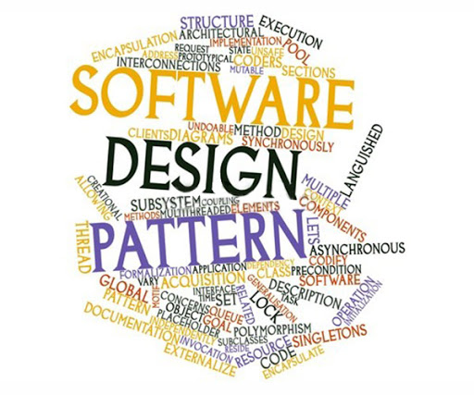
Agenda
Motivation
Design Patterns in Machine Learning
Data Representation Design Patterns
Problem Representation Design Patterns
Model Training Design Patterns
Reproducibility Design Patterns
Design Patterns in Internet of Things
IoT Architecture
IoT Design Patterns
Integration Patterns
Communication Patterns
Energy Saving Patterns
Security Patterns

Slide 3
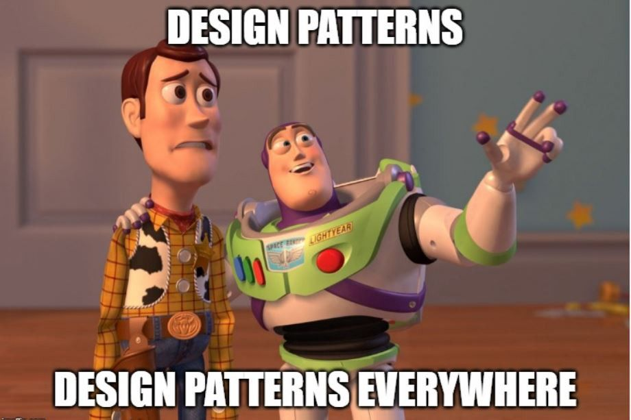
Motivation behind our Advanced Research Presentation
In the class of Advanced Software Engineering we have gone through different patterns in Creational, Behavioural and Structural. These design patterns helped us to understand when to use and how to use a design pattern.
As Computer Science students, We believe, we should have a hands-on experience on these patterns and also the design patterns that being researched and reported in different emerging technologies.

Slide 4
How are Design Patterns in Machine Learning observed
How are Design Patterns collected and reported in Machine Learning?
A systematic study is not presented to collect, identify and report how Design Patterns of Software Engineering are useful for Machine Learning.
The researcher do a systematic literature review focusing on method, architecture and design patterns, preliminary and quantitative results.
A group of ML developers are asked research questions regarding the Design Pattern in ML.
For example, How do ML developers perceive or tackle the design of ML System and Software?
Does academic and gray literature address the design of ML systems and software?

Slide 5
Common Challenges in Machine Learning
Data Quality:
Data Accuracy: Understanding where your data came from and any potential errors in the data collection process can help ensure feature accuracy.
Data Completeness: The data needs to be complete i.e. our data must contains all the scenarios of the attributes.
Data Consistency: The attributes in its unit has to be consistent. [ Kilometers, Miles]
Timeliness: Timeliness in data refers to the latency between when an event occurred and when it was added to your database.
Reproducibility:
Random Seed:When training a model we need to make sure that we are taking the recent data into our training model.
Notes:
Training a model on the incomplete dataset yields incorrect results.
Data Accuracy: Data accuracy refers to both your training data’s features and the ground truth labels corresponding with those features. Understand where the data is coming from.
Data Completeness:
One aspect of data completeness is ensuring your training data contains a varied representation of each label.
Data Consistency:
For an example of inconsistent features, let’s say you’re collecting atmospheric data from temperature sensors. If each sensor has been calibrated to different standards, this will result in inaccurate and unreliable model predictions.
Timeliness:
Timeliness in data refers to the latency between when an event occurred and when it was added to your database.

Slide 6
Common Challenges in Machine Learning
Data Drift:
It’s important to continually update your training dataset, retrain your model, and modify the weight your model assigns to particular groups of input data.
Scale:
Data Collection , Preprocessing, Training and Serving.
When ingesting and preparing data for a machine learning model, the size of the dataset will dictate the tooling required for your solution.

Slide 7
Machine Learning Design Patterns
Data Representation Design Patterns
Problem Representation Design Patterns
Model Training Design Patterns
Reproducibility Design Patterns
Design Patterns for Resilient Serving

Slide 8
Design Pattern 1- Hashed Feature
Related to: Data Representations design pattern in particular about the CATEGORICAL data.
Problem: The Hashed Feature design pattern addresses three possible problems
Incomplete Vocabulary. [ Due to random sampling we miss features in training data.]
Model size due to Cardinality. [ A feature with thousands of millions entries.]
Cold Start. [ New entries missing in the training set]
One-hot encoding a categorical input variable requires knowing the vocabulary beforehand.
This is not a problem if the input variable is something like the language a book is written in or the day of the week that traffic level is being predicted.
What if the categorical variable in question is something like the hospital_id of where the baby is born??

Slide 9
Example: Predicting the Arrival delay of a Flight:
One of the inputs to the model is the “departure airport”. Let us say at the time the dataset was collected, 347 airports in the United States:
Some airports had as few as one to three flights over the entire time period, and so we expect that the training data vocabulary will be incomplete. [Incomplete Vocab]
347 is large enough that the feature will be quite sparse. [ High Cardinality]
It is certainly the case that new airports will get built. [ Cold Start]
Solution:
Converting the categorical input into a unique string. Using three-letter IATA [ International Air Transport Association ]code for the airport.
Invoking deterministic[ no random seeds ] and portable hashing algorithm [same algo for both training and serving]
Taking the remainder when the hash result is divided by the desired number of buckets.

Slide 10

Implementation:
In BigQuery we achieve these steps:
The FARM_FINGERPRINT function uses FarmHash, a family of hashing algorithms that is deterministic, well-distributed, and for which implementations are available in a number of programming languages.
In TensorFlow, these steps are implemented by the categorical_column_with_hash function:
Categorical_column_with_hash_bucket:
Use this when your sparse features are in string or integer format
When we want to distribute your inputs into a finite number of buckets by hashing.

Slide 11
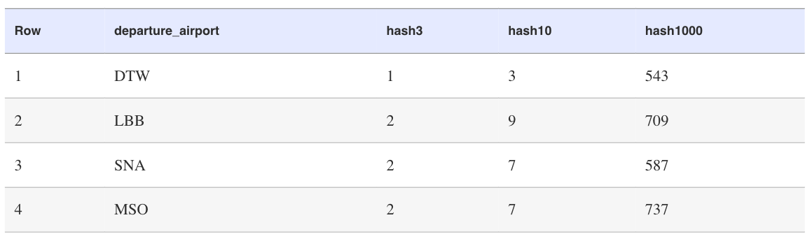
Results:
OUT-OF-VOCABULARY INPUT:
Even if an airport with a handful of flights is not part of the training dataset, its hashed feature value will be in the range [0–9].
Therefore, there is no resilience problem during serving—the unknown airport will get the predictions corresponding with other airports in the hash bucket. The model will not error out.
HIGH CARDINALITY:
It’s easy to see that the high cardinality problem is addressed as long as we choose a small enough number of hash buckets.
COLD START:
The cold-start situation is similar to the out-of-vocabulary situation. If a new airport gets added to the system, it will initially get the predictions corresponding to other airports in the hash bucket.

Slide 12
Design Pattern 2: Ensembles Design Pattern
Problem Representation Design Pattern:
The Ensembles design pattern refers to techniques in machine learning that combine multiple machine learning models and aggregate their results to make predictions.
Problem:
Suppose we’ve trained a baby weight prediction model, engineering special features and adding additional layers to our ML Model so that the error on our training set is nearly zero.
However, when we evaluate performance on the hold out test set, our predictions are all wrong. What happened? And, more importantly, how can we fix it?
To better understand where and how our model is wrong, the error of an ML model can be broken down into three parts:
Irreducible error [ Inherent error in the model resulting from noise in the dataset]
Error due to bias [ Inability to learn enough about the relationship between the model’s features ]
Error due to variance [ inability to generalize on new, unseen examples]

Slide 13
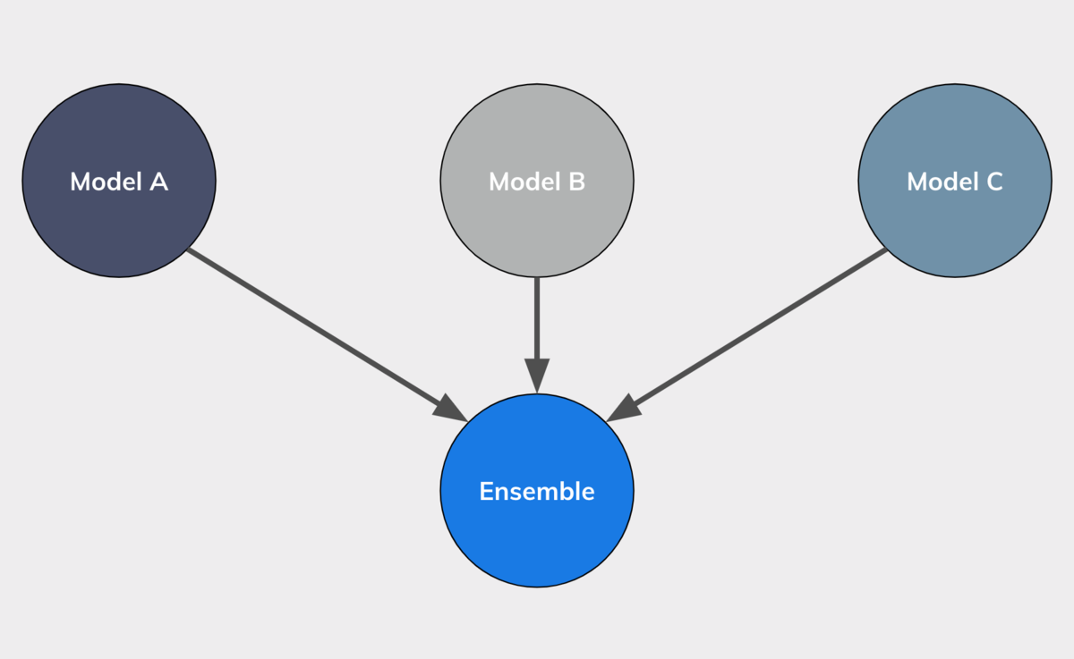
Solution:
Ensemble methods are meta-algorithms that combine several machine learning models as a technique to decrease the bias and/or variance in improving the model performance.
Generally speaking, the idea is that combining multiple models helps to improve the machine learning results.
By building several models with different inductive biases and aggregating their outputs, we hope to get a model with better performance.

Slide 14
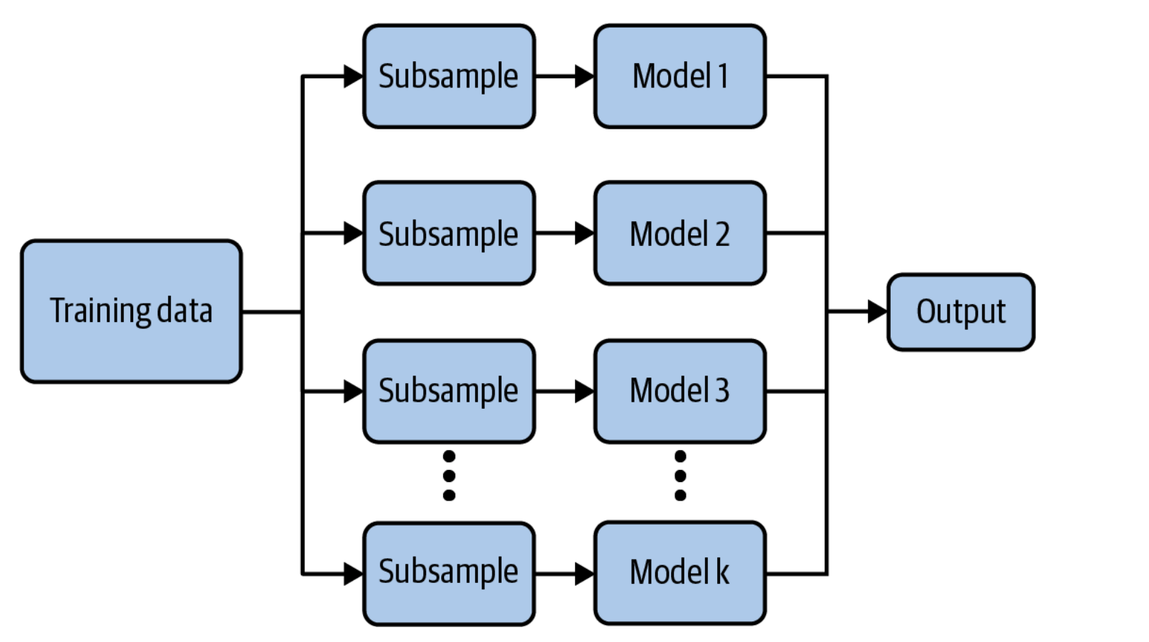
Ensemble method 1 - Bagging
Bagging is a type of parallel ensembling method and is used to address high variance in machine learning models.
Specifically, if there are k submodels, then there are k separate datasets used for training each submodel of the ensemble.
Example:
A good example of a bagging ensemble method is the Random Forest.
Multiple Decision Trees are trained on randomly sampled subsets of the entire training data, then the tree predictions are aggregated to produce a prediction.
With bagging, the model and algorithms are the same. For example, with random forest, the submodels are all short decision trees.

Slide 15
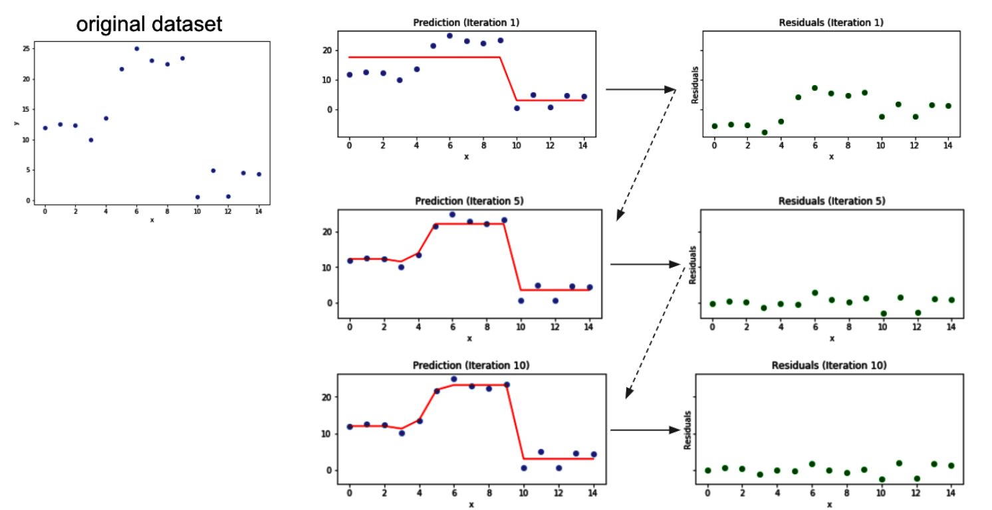
Ensemble Method 2 - Boosting
The idea behind Boosting is to iteratively build an ensemble of models where each successive model focuses on learning the examples the previous model got wrong.
In short, boosting iteratively improves upon a sequence of weak learners taking a weighted average to ultimately yield a strong learner.
Some of the more well-known boosting algorithms are
AdaBoost
2. Gradient Boosting Machines
XGBoost
They have easy-to-use implementations in popular machine learning frameworks like scikit-learn or TensorFlow.

Slide 16
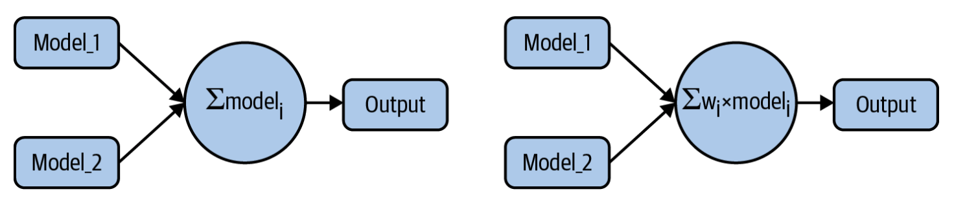
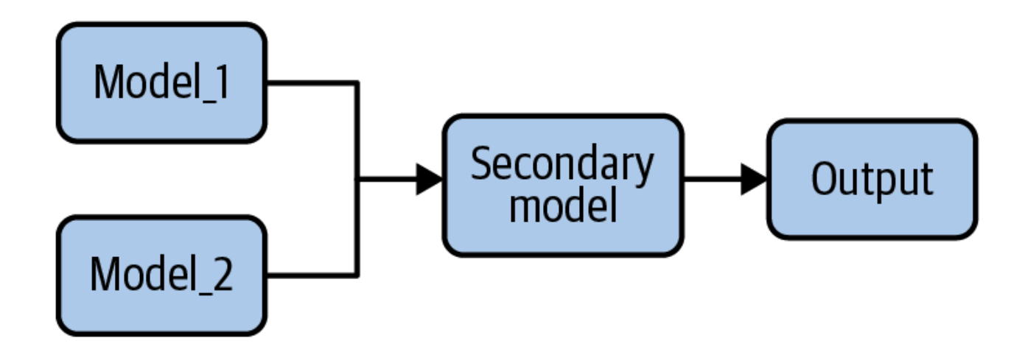
Ensemble Model 3 - Stacking
Stacking is an ensemble method that combines the outputs of a collection of models to make a prediction.
Stacking is an ensemble learning technique that combines the outputs of several different ML models as the input to a secondary ML model that makes predictions.

Slide 17
ML Design Pattern - 3 - Checkpoints
Related to: Model Training
In Checkpoints, we store the full state of the model periodically so that we have partially trained models available.
These partially trained models can serve as the final model (in the case of early stopping) or as the starting points for continued training (in the cases of machine failure and fine-tuning).
Problem
The more complex a model is , the larger the dataset that is needed to train it effectively.
More Complex Model → More Tunable Parameters
Model Size Increases → Time to fit once batch increases
Example: The more layers and nodes a neural network has.
When we train that takes long, the chances of machine failure are uncomfortably high. If there is a problem, we’d like to be able to resume from an intermediate point, instead of from the very beginning.

Slide 18
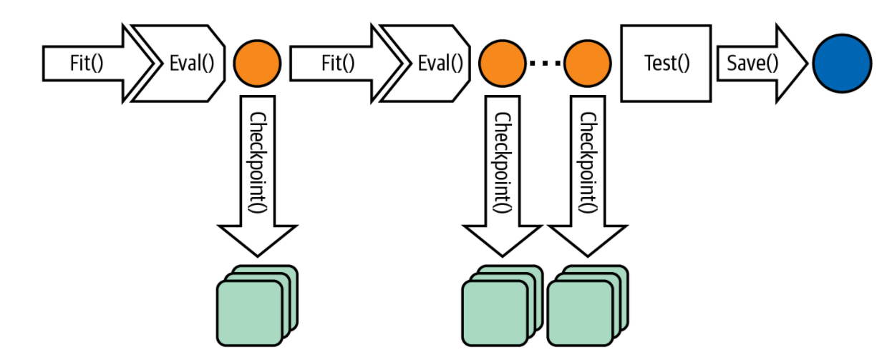
Solution:
Save the model at the end of every epoch. Then, if the training loop is interrupted for any reason, we can go back to the saved model state and restart.
However, when doing this, we have to make sure to save the intermediate model state, not just the model.
Once training is complete, we save or export the model so that we can deploy it for inference.
Decision Tree Model: This would be final rules for each intermediate node and the predicted value for each of the leaf node.
Linear Regression Model: This would be the final values of the weights and biases.
Fully Connected Neural Network: Activation functions and the weights of the hidden connections.

Slide 19
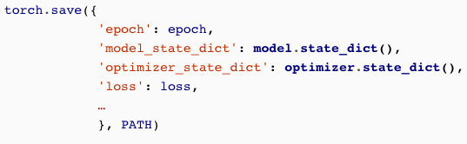
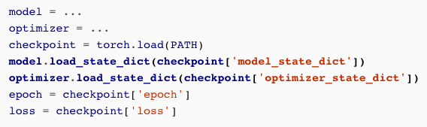
CHECKPOINTS IN PYTORCH
PyTorch doesn’t support checkpoints directly. But it does by externalizing the state of most objects.
To implement this we need epoch, model state, optimizer state and any other information needed to resume training to be serialized along with model.
Saving the State →
Retrieve the State →

Slide 20
ML Design Pattern - 4
Reproducibility - Transform Design Pattern
The Transform design pattern makes moving an ML model to production much easier by keeping inputs, features, and transforms carefully separate.
The Problem: Features != inputs.
The problem is that the inputs to a machine learning model are not the features that the machine learning model uses in its computations.
Example:
In a Machine Learning text classification model, for example, the inputs are the raw text documents and the features are the numerical embedding representations of this text.

Slide 21
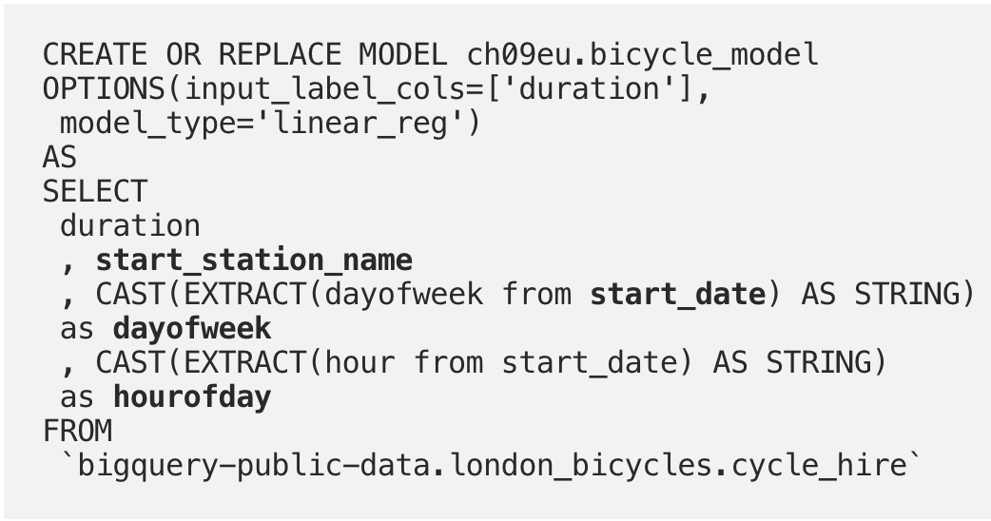
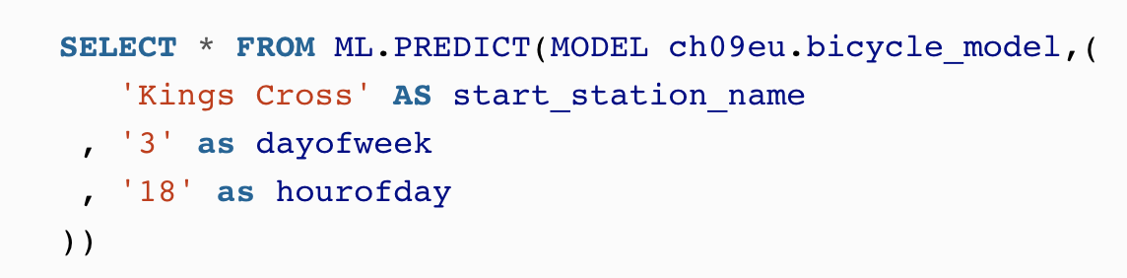
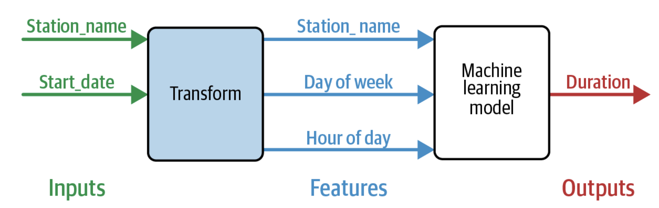
ML Design Pattern - 4
But the SQL code mixes up the inputs and features and doesn’t keep track of the transformations that were carried out.
This comes back to bite when we try to predict with this model.
We have to know that we need to send in '3' for dayofweek. That '3' …is that Tuesday or Wednesday?
Depends on which library was used by the model, or what we consider the start of a week!

Slide 22
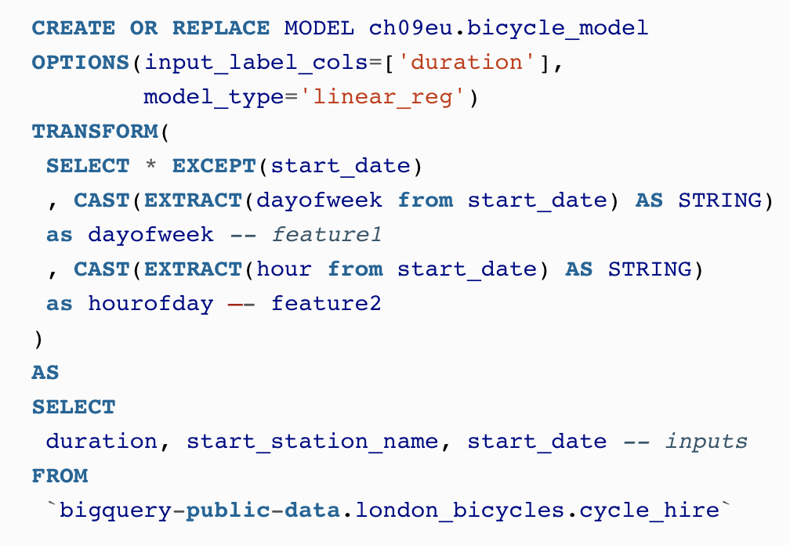
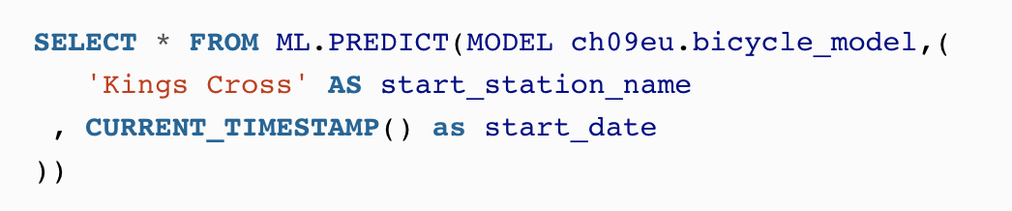
Solution:
The solution is to explicitly capture the transformations applied to convert the model inputs into features.
In BigQuery ML, this is done using the TRANSFORM clause. Using TRANSFORM ensures that these transformations are automatically applied during ML.PREDICT.
We have clearly separated the inputs (in the SELECT clause) from the features (in the TRANSFORM clause).
We can simply send to the model the station name and a timestamp (the inputs):

Slide 23
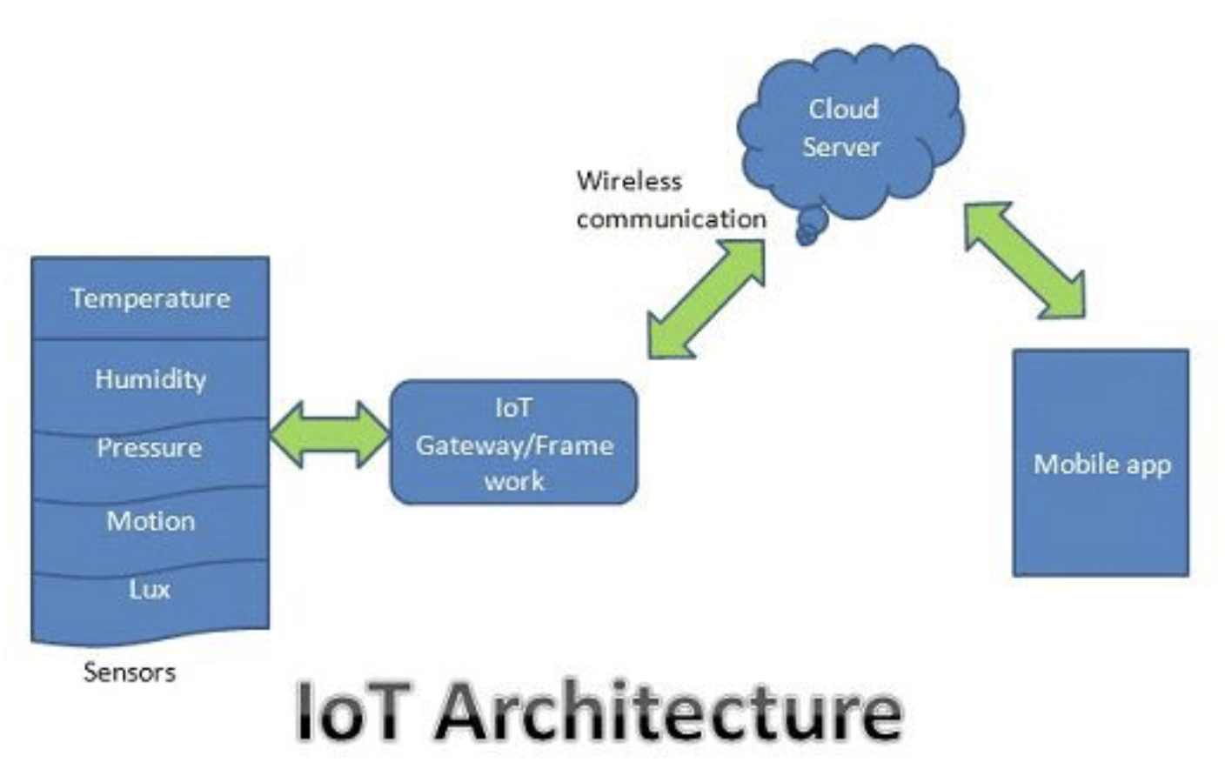
IoT Architecture
Sensors will sniff a wide variety of information ranging from Location, Environment conditions, running machine, from the human body, engine maintenance data to health essentials of a vehicle.
IoT gateway & frameworks is a gateway to the internet for all the devices that we want to interact with. Gateways act as a carrier between the internal network of sensor nodes with the external Internet.
In Cloud server the data transmitted through the gateway is stored & processed securely within the cloud server. This processed data is then used to perform intelligent actions that make all our devices Smart Devices.
Mobile Apps will help end-users to control & monitor their devices and push important information from the cloud on your smartphones. From mobile applications, we can send a command to sensors to change default values.

Slide 24
Design Patterns in Internet of Things
Challenges
All the patterns which we discuss help IoT architects and developers with understanding and building of IoT products.
The design patterns summarize the experience of specialists and offer the ability to solve some of the systems development problems.
Basing on architecture layers and categories, Researchers have proposed grouping of patterns and use a right pattern in a project situation.
Communication security and reliability
Choice of right architecture

Slide 25
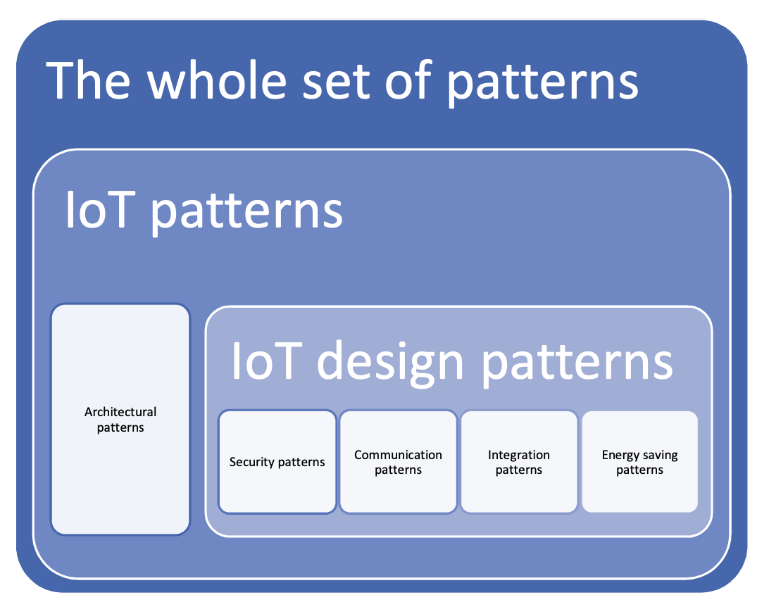
IoT Design Patterns
Based on Level of Abstraction, patterns are divided into
architecture layers.
High Level or Architecture Patterns
Mid-Level or Design Patterns
Low-Level or Software-dependent Patterns
Based on Domain specificity, patterns are divided into three types.
Any Patterns
General IoT Patterns
Specific IoT Patterns
All systems and software design patterns address scalability and privacy.

Slide 26
Architectural Patterns
Determines how the elements of the system are organized, interacted and suggest to build a single system in a heterogeneous system.
Components are introduced into the system to allow the creation of different types of integration and communication of its components.
These include Device-to-Device, Network-to-Network, Middleware-to-Middleware, Application & Services-to-Application & Services, and also provide protection on different architecture levels.
IoT Architecture Pattern provides a three-tier architecture with User Interfacing Layer, Interconnection and Logic Layer, Computation and Data Storage Layer.

Slide 27
Integration Patterns
Ensure ways to combine devices located at different end nodes with different protocols in an IoT platform.
To solve the physical infrastructure of IoT in different networks and devices we use the following patterns.
Edge Provisioning Pattern
Edge Code Deployment Pattern
Edge Orchestration Pattern
Edge Diameter of Things
All the above patterns comes under the category of Low Abstraction Level and General specificity.

Slide 28
Communication Patterns
Communication patterns are architectural concepts describing how messages are transported in the network to accomplish certain tasks in the devices.
Devices in the IoT can be categorized into groups according to their computational and communication capabilities.
Devices can operate in different modes depending on their communication frequency and their need to save energy.
Device Types
Unconstrained Devices
Semi-Constrained Devices
Constrained Devices
Device Operation Modes
Always-On
Low-Power
Normally-Off

Slide 29
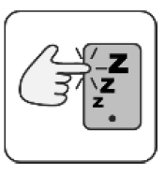
Communication Patterns
The Device Wakeup Trigger pattern involves sending a message over a communication channel to a device control unit that is not permanently connected to the network.
Problem: Some devices might go into a sleep mode to conserve energy and only wake up from time to time to reconnect to the network. During sleep they are not reachable on their regular communication channels.
Solution: Implement a mechanism that allows the server to send a trigger message
to the device via a low energy communication channel. Have the device receive
those triggering messages and immediately establish communication with the server when it receives a message.
Other patterns like Device Gateway Pattern, Device Shadow Pattern, Rule Engine
Pattern, Delta Update Pattern, etc.

Slide 30
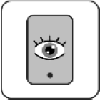
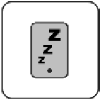
Energy Saving Patterns
The Always-On Device pattern refers to cases where energy saving is inefficient.
Problem: You have a device with an unlimited energy supply and need to have it
available and responsive at all times.
Solution: Leave the device turned on and connected to power at all times.
The Normally-Sleeping Device pattern is used in cases where the device does not need to operate continuously and is implemented by deactivating all its energy elements.
Problem: You have a device with a limited energy supply. You want to minimize the
power used by the device.
Solution: Program the device to disable its main components when they are not needed. Leave a
small circuit powered which reactivates the components after a predefined
amount of time has passed.

Slide 31
Security Patterns
While developing IoT software system, secure communication between objects is considered.
Security Patterns as an architectural pattern to describe global software architecture concepts.
Security Patterns as an design pattern in case of building the applications.
A security pattern is not directly related to a vulnerability, but is directly related to a threat. The specific threat may be the result of one or more vulnerabilities, but the pattern is not intended to repair the vulnerability, but to stop or mitigate the threat.
Some of the security patterns are Trusted Communication Partner, Permission Control, Outbound-only Connection, Personal Zone Hub, Whitelist and Blacklist etc.,

Slide 32
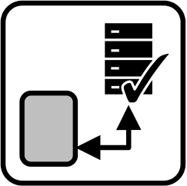
Trusted Communication Partner
Context: In the IoT, devices may communicate with many other communication partners, such as backend servers, applications, or other devices. Some of these connections may be used regularly while others are used infrequently.
Problem: In a dynamic environment there may be multiple potential communication partners available for a device. These may not be known or trusted and may pose a security risk as attackers may try to use them to get access to devices and their networks.
Solution: Configure the device with a list of communication partners that you trust. Only allow incoming or outgoing communication with these Trusted Communication Partners and block other communication attempts.

Slide 33
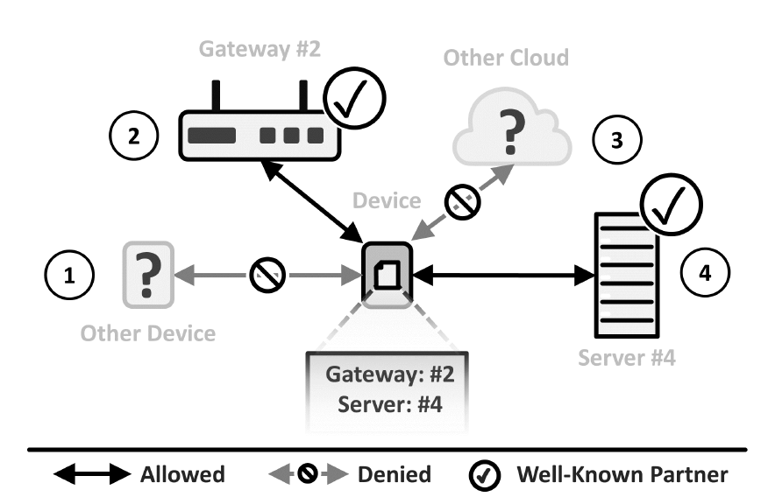
Solution Details:
Each device is configured to only communicate with a limited selection of Trusted Communication Partners which are placed on the device during bootstrapping.
Trusted Communication Partners may be implemented in form of single entries in a configuration file.
On the device, a component checks each incoming and outgoing connection. If the connection source or target connections matches the entry in the configuration file, it is allowed to pass.
Otherwise, the connection is blocked and logged.
For some use cases, it make sense to only use Trusted
Communication Partners for certain functionality.
Benefits:
Decreased Attack Surface
Explicit Allowance

Slide 34
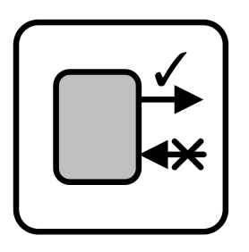
Outbound-Only Connection
Context: Devices send data to other devices for monitoring, analysis, or storage purposes. They also receive commands which control or trigger functionality built into them. This communication poses a security risk as attackers might try to gain access to devices to manipulate them.
Problem: Devices are a target for attackers who try to gain access to their network. They may send unsolicited communication requests to the devices to get them to connect to an infected communication partner or to misuse them.
Solution: Program devices so that only they initiate connections. Deny all incoming communication requests that are not responses to a connection already created
by the device.

Slide 35
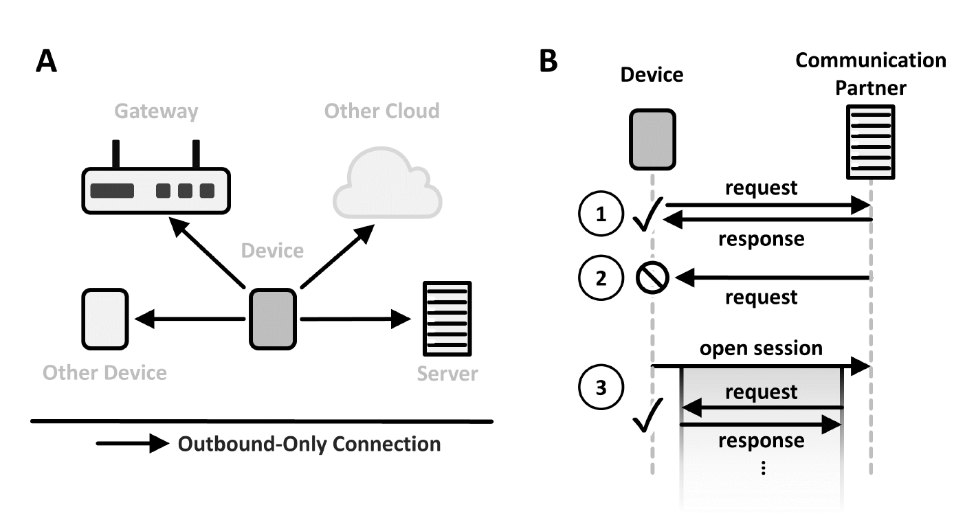
Solution Details:
All communication partners should be stored in configuration file or database, which is stored on the device during bootstrapping.
The device may use certain events, such as sensor reading above a threshold or other parameters to work out when it needs to communicate with others.
Here, it is creating a long lasting session, which allows its communication partner to send messages as long as the connection remains active.
Outbound-Only Connection does not restrict bidirectional communication once a connection is established but it does restrict the initial creation of a connection from the outside.
Benefits:
Security
Low Energy

Slide 36
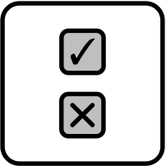
Permission Control
Context: In the IoT there are often multiple stakeholders involved, such as owners, and users. Building and using IoT solutions often requires communication between the components of other stakeholders, like communication between devices and a backend server, as data and functionality are shared.
Problem: Device owners are afraid to completely hand over access to their devices and data to third parties without any control. Often, it is unclear what data a device shares with communication partners or what others can access and control.
Solution: When first connecting a device to a backend server, require an explicit choice from the user regarding which functionality and data the backend and other communication partners are allowed to use. Build your backend server so that it adheres to these choices. Require the
user to confirm these choices if something on the device or the backend server
changes.

Slide 37
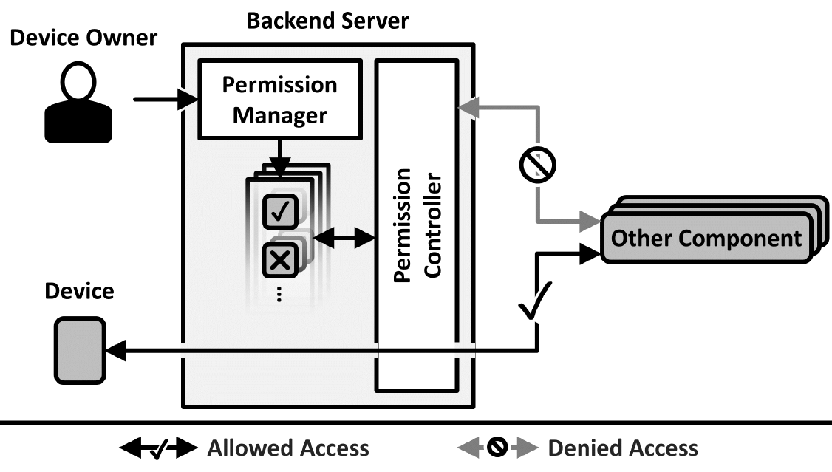
Solution Details:
Before a device is added to the Backend Server or before another communication partner is allowed to access the device, the device owner is presented with a Permission Manager interface where he has to explicitly allow or deny the communication partners some rights.
The job of Permission Controller is to grant authorization.
Granted Authorizations have to be enforced each time if another component wants to access the functionality of a particular device.
Devices or components can change, every time any change occurs, you should require the user to confirm or alter his previously granted permissions.
Benefits:
Explicit Choice
Transparency

Slide 38
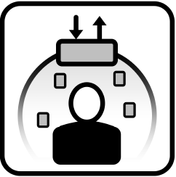
Personal Zone Hub
Context: Devices usually have an owner, such as a person or an organization. Together, they create the personal zone of their owner. This personal zone may contain all kinds of devices, applications, and data that may allow others to identify, track, or gain insights about the owner. Thus, the owner is usually interested in controlling and restricting access to his personal zone.
Problem: Users have an increasing number of IoT devices. Managing the permissions, data sharing and control of these devices across multiple gateways and cloud systems is complex.
Solution: Create a Personal Zone Hub which unifies the management and control of all devices, services, apps, and data of one user into a single, trusted system. Make the hub permanently addressable. Allow the user to selectively share access to some or all the data and functionality encompassed by the zone.

Slide 39
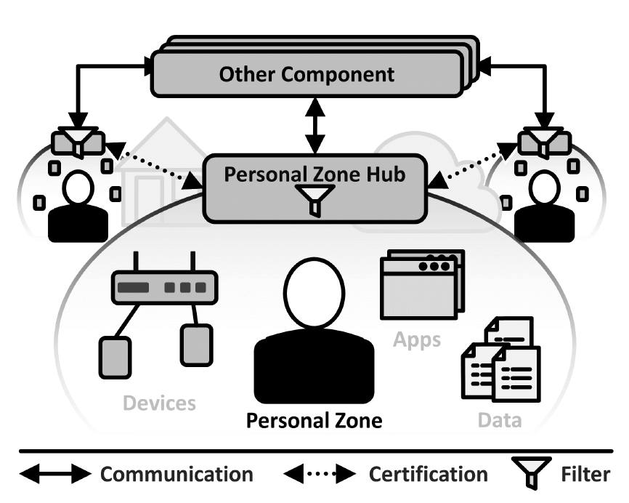
Solution Details:
A personal zone encompasses the pool of digital resources belonging to one person.
Conceptually it creates a logical boundary around a person and all of their devices, apps, services, and data.
Technically, it combines multiple types of devices and networks, connected or disconnected, as well as cloud providers through a virtual network.
The Personal Zone Hub controls access to the personal zone through a logical Firewall, where the owner may allow different parties to access all components, or data.
To address each hub uniquely we use a routable URL, by placing the Personal Zone Hub into a cloud, where it is accessible for other communication partners.
Benefits:
User Control
Trust

Slide 40

Whitelist
Context: For IoT systems to work, communication partners need privileges to access parts of others. To minimize the risk of abuse, add identifiers of all trusted communication partners to a Whitelist. Block the privileges controlled by the Whitelist for those who are not on it.
Problem: Privileges may be abused and attackers may try to overwhelm a system with requests. Using a
Blacklist to block known abusive communication partners helps, but such a list is never complete. There has to be a mechanism to limit access to known communication partners to minimize the possible range of attacks.
Solution: Implement a Whitelist to which identifiers of communication partners may be added with an administrative interface. Implement checks for every privilege which the Whitelist controls. If such a privilege is requested and the requester’s identifier is on the Whitelist, allow it to
proceed. If not, deny the request.
Notes:
Available privileges may be abused, but not all potential abusers are known beforehand. To minimize the risk of abuse, add identifiers of all trusted communication partners to a Whitelist. Block the privileges controlled by the Whitelist for those who are not on it.
Context: For IoT systems to work, communication partners need privileges to access parts of others. Some examples include devices that need access privileges on the backend server to send it their data, or applications that need privileges to access certain functionality or to be executed on a device or a server. Some privileges may be freely available by
default, but others should only be made available to trusted partners. In both cases, abuse is a problem which has to be handled. This can be done by using the Authenticator pattern [Schumacher et al. 2005], which relies on cryptographic mechanisms and tokens but requires some processing power. Thus, this may not be applicable everywhere in IoT
systems, where very constrained devices may not have enough resources to execute such a mechanism. Besides, tokens used by these mechanisms may be stolen and used on other devices, or devices may be stolen and used from other locations. Denial-of-service attacks might also be a problem. Such illegitimate request should be blocked to not waste
too many resources on them.

Slide 41

Blacklist
Available privileges may be abused. To stop this, implement a Blacklist to which identifiers of abusive communication partners can be added. For each partner that requests a privilege first check this list and deny it if its identifier is found on it.
Problem: Privileges, no matter if freely available or explicitly granted, may be abused. There has to be a mechanism to stop existing abuse and to limit potential future abuse.
Solution: Implement a Blacklist to which identifiers of abusive communication partners can be added with an administrative interface. Implement checks for every privilege that the Blacklist controls. If such a privilege is requested and the identifier of the requesting communication partner is on the Blacklist, block it. If not, allow it to proceed.
Notes:
Context: For IoT systems to work, communication partners need privileges to access parts of others. Some examples include devices that need access privileges on the backend server to send it their data, or applications that need privileges to access certain functionality or to be executed on a device or a server. Some privileges may have to be explicitly granted, others may be freely available. In the latter case, abuse is a problem which has to be handled. But even when privileges are explicitly granted, abuse is still possible, for example if a device is hijacked by a malicious intruder.

Slide 42
Questions…!!

